Slide 1
Market Segmentation & How to do Primary Market Research
or
“Now that I have my idea and team, what do I do next?”
Session 7

Slide 2
What Should We Be?
Target Customer-Driven
Market-Driven

Slide 3
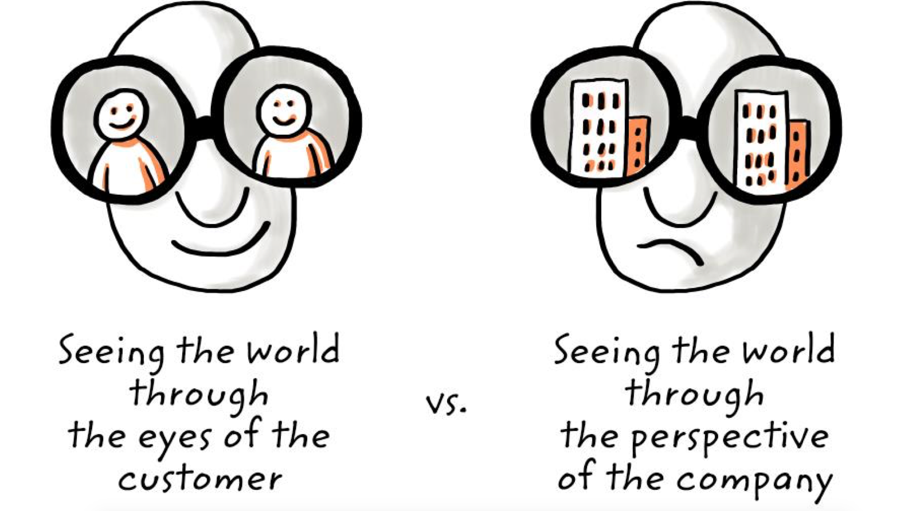
Secret of success

Slide 4
Who is my customer?
“Customer” refers to the entity, such as a household, organization, or individual who pays for, acquires, and uses your product

Slide 5
Customer Vs End User
Within the broad definition of a customer are:
End User: who ultimately uses your product
Economic Buyer: who makes the final decision to purchase your product

Slide 6
Watch out for complex cases!
The customer and end user can be the same person or different persons depending on the situation.
In multi-sided markets or business-to-business settings, your customers and end users are likely to be different people.

Slide 7
Market Segmentation: Objective
Identify a multitude of markets that could be potential opportunities – markets with a problem that your product/service can solve.
Break these markets into segments,
Do direct market research on several to decide which of these markets is best for you.
There will likely be many paths to success and it is important that you choose one but not necessarily the perfect one.
There likely is no perfect one.
It is better to try a market and find out if it will work out and learn that it will not rather than be a state of “analysis paralysis”.

Slide 8
Market segmentation allows you..
to capture a wide spectrum of market opportunities and understand the pain points of your consumer
You are able to design a solution that will be of great value to them.
This research will also help you select a beachhead market.

Slide 9
Market Segmentation
Step 1A: Brainstorm
Step 1B: Narrow
Step 1C: Primary Market Research

Slide 10
Market Segmentation: Brainstorm
Start by brainstorming a wide array of market opportunities
Include all the “crazy” long-shot ideas because they are helpful in expanding the boundaries of possibilities to where some of the most interesting opportunities might exist

Slide 11
Then identify potential industries for your idea
List who might benefit in each industry from your idea
Focus on end users, not customers, because you need a committed group of end users to have a sustainable business

Slide 12
Next, identify the different tasks your
end user performs
There may be similarities between certain subcategories that you can group but do not start combining categories without knowing more about your customer

Slide 13
Important Note!
When segmenting, you will find there are a lot of segments and that seemingly broad categories have a lot of important differences
Be broad and expansive when segmenting end users for your new product. You are brainstorming now, later you will narrow the list as you analyze each segment

Slide 14
Market Segmentation: Narrow
After identifying numerous potential end users and applications for your idea or technology, the next step is to list the top 6-12 interesting market opportunities
Market opportunity = specific end users + unmet need

Slide 15
Start by asking the following 7 questions at an industry level
Then consider what the answers would be for the end user of your product
Since you will be researching each of these markets in depth, you don’t have time to consider an unlimited number of options.
6-12 market opportunities is more than sufficient (with 6 being a much more realistic number)

Slide 16
Narrow – Question 1
Is the target customer well-funded?
If the customer doesn’t have money, the market is not attractive because it will not be sustainable and provide positive cash flow for the new venture to grow

Slide 17
Narrow – Question 2
Is the target customer readily accessible to your sales force?
You want to deal directly with customers when starting out instead of relying on third parties to market and sell your product, because your product will go through iterations of improvement very quickly, and direct customer feedback is an essential part of that process.
Also, since your product is relatively new and never seen before (and potentially disruptive), third parties may not know how to be effective at creating demand for your product

Slide 18
Narrow – Question 3
Does the target customer have a compelling reason to buy?
Would the customer buy your product instead of another similar option?
Or, is the customer content with whatever solution is already being used?
On many occasions, your primary competition will be the customer doing nothing

Slide 19
Narrow – Question 4
Can you today, with the help of partners, deliver the whole product?
Your customer usually wants to buy a whole functional solution, not one they have to assemble themselves.
You will likely have to work with other vendors to deliver a solution that incorporates your product, which means that you will need to convince other manufacturers and distributors that your product is worth integrating into their workflows (eg Ikea-Urban Ladder)

Slide 20
Narrow – Question 5
Is there entrenched competition that could block you?
It is rare to enter a market with no other competitor.
How strong are these competitors, from the customer’s viewpoint (not your viewpoint or from a technical standpoint)?
Can the competition block you from starting a business relationship with a customer?
And how do you stand out from what your customer perceives as alternatives?

Slide 21
Narrow – Question 6
If you win this segment, can you leverage it to enter additional segments?
If you dominate this market opportunity, are there adjacent opportunities where you can sell your product with only slight modifications to your product or sales strategy?
Or will you have to radically revise your product or sales strategy in order to take advantage of additional market opportunities?
While you want to stay focused on your beachhead market, you do not want to choose a starting market from which you will have a hard time scaling your business

Slide 22
Narrow – Question 7
Is the market consistent with the values, passions, and goals of the founding team?
You want to make sure that the founders’ personal goals do not take a back seat to the other criteria presented here

Slide 23
How Do We Fill In the Matrix?
Start a market matrix
The matrix is filled in from Primary Market Research – this information is not collected by you sitting in a class room, debating in a library, by doing internet searches or reading reports
This needs to be Primary Market Research from direct interaction with real potential customers about their situations, pain points, opportunities, and market information!

Slide 24

Market opportunities example
M/s Haptic devices
Allows realistic touch of digital world

Slide 25
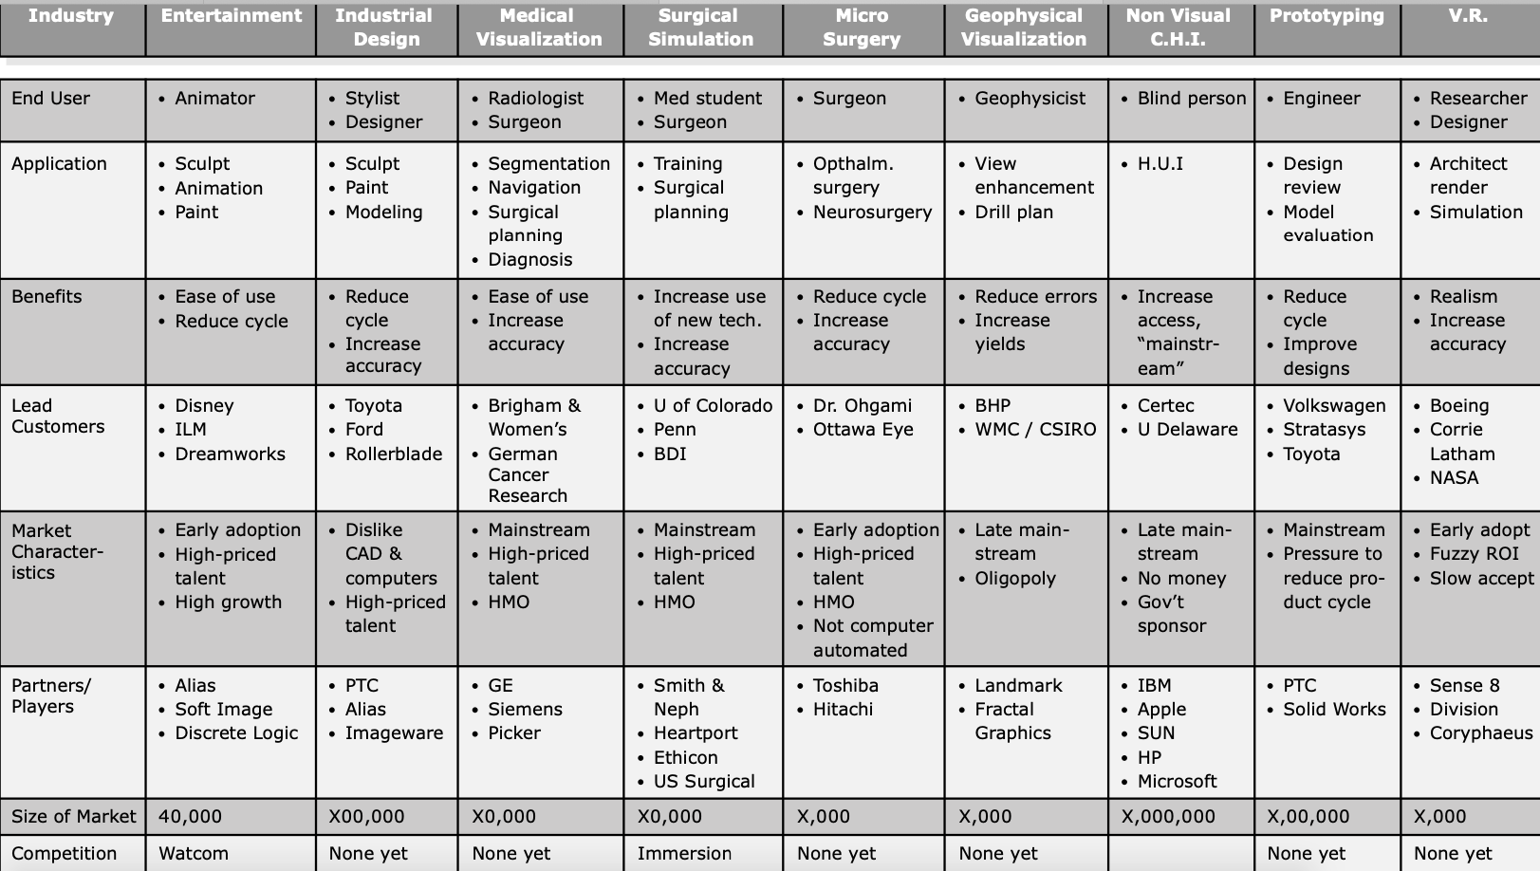

Slide 26
Class Exercise with Team
• Make a matrix for the various market segments for your team’s project.
• Fill only the first two rows.

Slide 27
How Do We Fill In the Matrix?
You are creating a new market or better yet addressing an existing market that is significantly underserved today.
It is highly unlikely that anyone has done the research that is appropriate to your opportunity and if they have, you should wonder if it is too late
Therefore, the best market research is what you will do yourself NOT something you will buy
Hence you have to learn how to do primary market research with a well defined target market & really understand their needs & opportunities

Slide 28
Primary Market Research
The 9 main categories you want information for each market include:
End User: Who specifically will be using your product?
Application: What would the end user be using your product for? What is the task that would be improved by your new venture?
Benefits: What is the actual value that the end user would gain from the use of your new product? What specifically does the user gain from the product.

Slide 29
Primary Market Research
Lead Customers: Who are the most influential customers that others look to for thought leadership and adoption of new technology?
Market Characteristics: What about this market would help or hinder the adoption of new technology?
Partners/Players: Which companies will you need to work with to provide a solution that integrates into the customer’s workflow?

Slide 30
Primary Market Research
Size of the Market: Estimate, how many potential customers exist if you achieve 100% market penetration?
Competition: Who, if anyone, is making similar products – real or perceived? This is from the customer’s perspective, not yours.
Complementary Assets Required: What else does your customer need in order to get the “full solution,” or full functionality from your product?

Slide 31
Primary Market Research
How Much Time To Spend:
Full attention to research should last at least a few weeks or a bit longer if your situation allows
The amount of time you spend mainly depends on how good your team is at getting primary market research
You should spend enough time so that you can fill out the matrix for all your top segments with some accuracy

Slide 32
Tenets of PCR/PMR
3 important things to keep in mind when conducting primary market research:
You do not have “the answer” for your potential customers and their needs
Your potential customers do not have “the answer” for you
Talk with potential customers in “inquiry” mode, not “advocacy/sales” mode. Listen to what they have to say, and don’t try to get them to buy anything

Slide 33
Primary Market Research
DO NOT just search the internet.
Don’t get stuck in analysis paralysis. This should not be a never-ending process.
Goal is to get an accurate assessment of the market opportunities so you can move on to the next step

Slide 34
4 mistakes in Primary Research
You ask people questions who give you the answer they think you are looking for (selection bias)
Your research is based on “friends” and is not replicable (social acceptability bias)
Your sample size or methodology is flawed (lacks structured process)
You bias your research to give you the answers you want (confirmation bias)

Slide 35
Tools of primary market research
Customer interviews
Observational research
Immersion
User tests (A/B testing)
Market survey
Focus groups
User driven innovation
Outcome driven innovation

Slide 36
Primary Market Research Plan
Goals and objectives
Description of research technique
Recruitment criteria for interviewees
Recruitment questionnaire
Supporting content (DIscussion guide, landing page, online survey)
Recruit subjects
Run the research program
Digest results

Slide 37
Primary Market Research Steps
Start with secondary research (but not too much)
Don’t start with a survey because you first have to figure out the questions to ask in a survey. Start with obtaining demographic and psychographic characteristics to match your target survey group. Then ask open ended questions. Tell us the last time you did X. Why? Why not? Ask for specific examples. Probe for the biggest pain points. Let the customer take the conversation where they want
If possible, have two people conducting the interview
In qualitative stage, small number of candidates are OK for refining your survey questions. In quantitative stage, use more candidates

Slide 38
Primary Market Research Steps
Source candidates to engage with
Physical watering holes
FB, Linkedin etc
Online discussion groups
Industry groups
Ads on google or FB
Who else do you know that has a similar problem?
Initial cold contact. Convince them to give you 15 minutes
Act like a great journalist (empathy, nod your head a lot, non-judgemental, make the person being interviewed feel like the most important person)
Make sure you are interviewing people in target customer group

Slide 39
Primary Market Research Steps
You should be surprised
Once credible hypothesis is formed by interview/immersion/observation, test them out systematically through structured scripts and surveys. This data will help you validate, invalidate, somewhat validate or somewhat invalidate your hypothesis
Don’t always believe what is said. People say things with the best of intents but do different things in reality

Slide 40
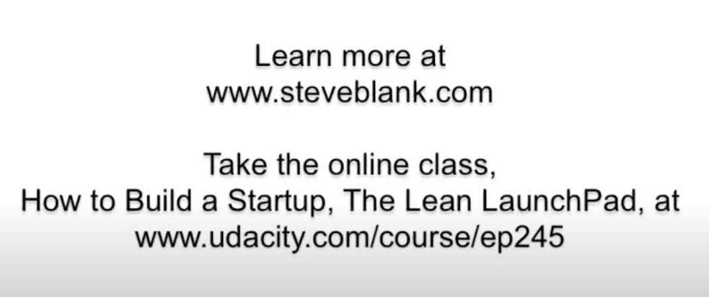
The customer development process
Steve Blank
https://www.youtube.com/watch?v=xr2zFXblSRM

Slide 41
PCR Case Study-Stew Leonard
https://www.youtube.com/watch?v=zimgmAWKvwM

